Slide 1

Rating Prediction

Slide 2
Problem Statement
In E-commerce website like flip-kart, amazon etc people write different reviews for technical products. Now these type of farm are like to adding a new feature to their website i.e. The reviewer will have to add stars(rating) as well with the review. The rating is out of 5 stars and it only has 5 options available 1 star, 2 stars, 3 stars, 4 stars, 5 stars. Now, they want to predict ratings for the reviews which were written in the past and they don’t have a rating. So, I have to build an application which can predict the rating by seeing the review.

Slide 3
About Dataset
The data scraping done from flip-kart and amazon.
There are 114491 rows and 3 columns in the dataset.
All 3 columns are of object type.
There are 2 columns which are of object type.
There is null value in the dataset.

Slide 4
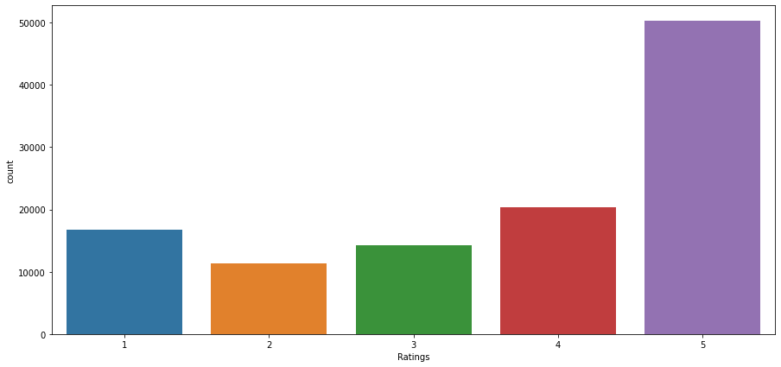
Exploratory Data Analysis
Ratings with 5 stars are most.

Slide 5
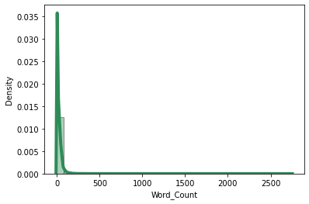
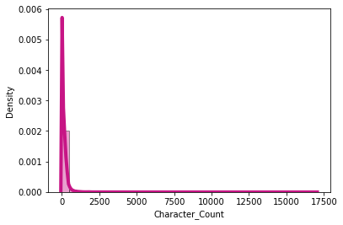
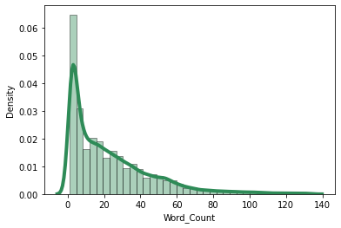
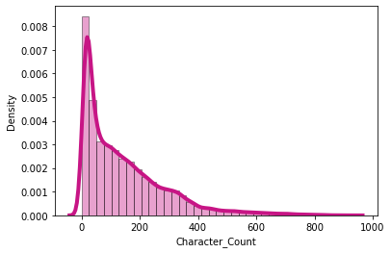
Word Count & Character Count
Word count is most between 0 to 140.
Character count is most between 0 to 1000.
Word Count & Character Count After Removing Outliers

Slide 6
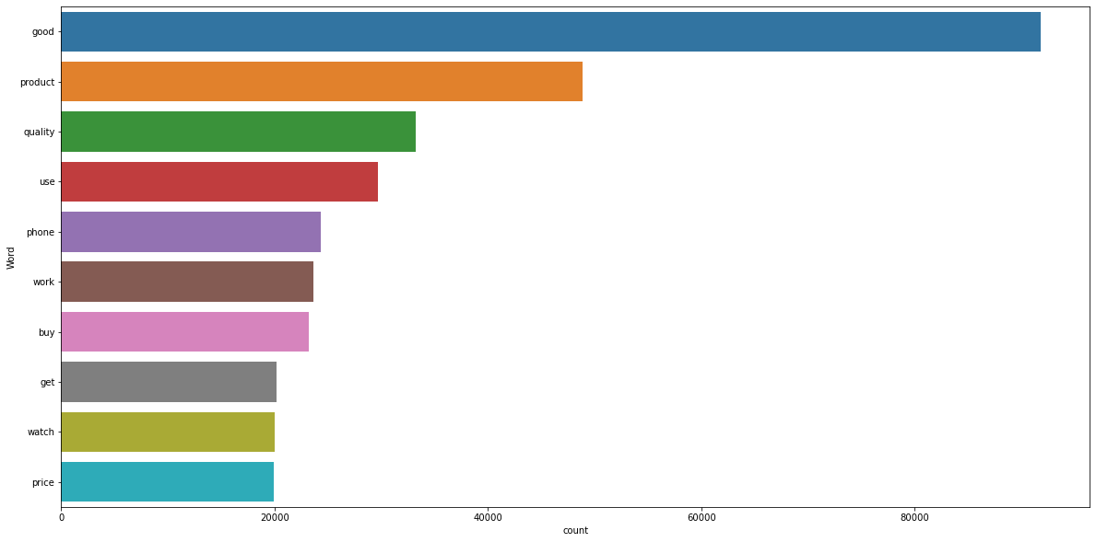
Top 10 Most Frequently Used Word

Slide 7
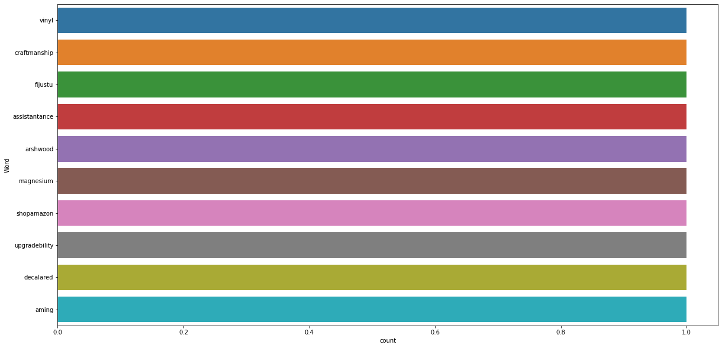
Top 10 Rarely Used Word

Slide 8
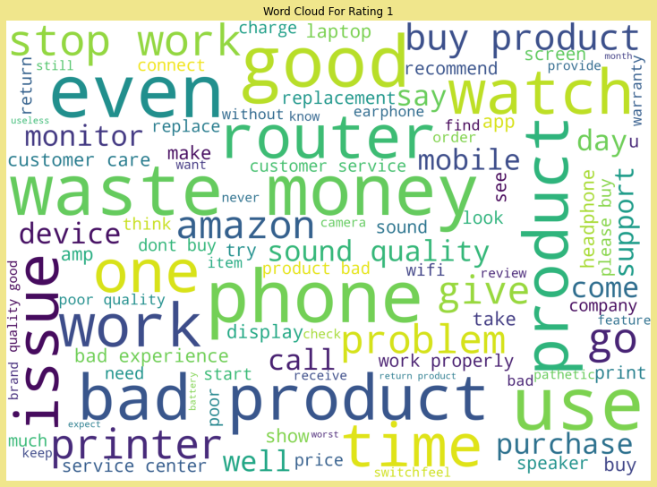
Word Cloud For Rating 1

Slide 9
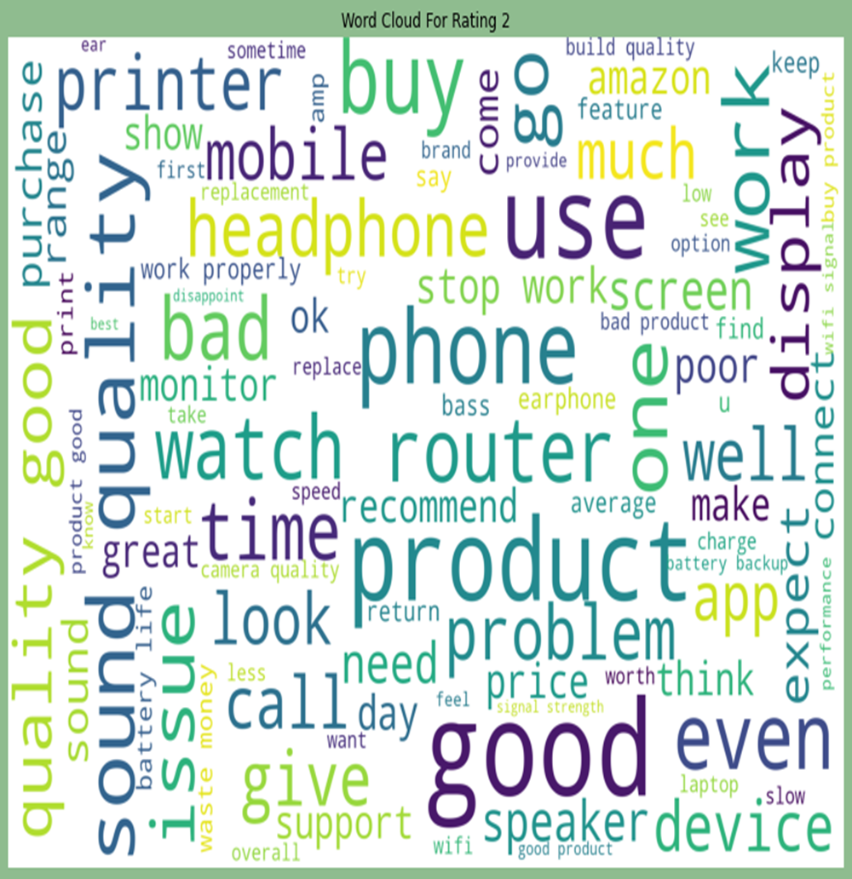
Word Cloud For Rating 2

Slide 10
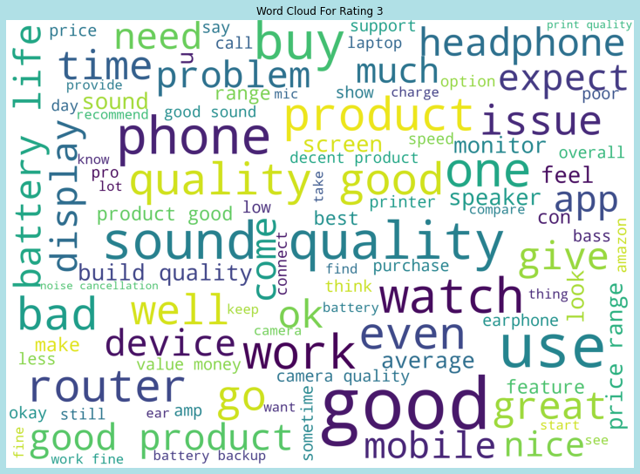
Word Cloud For Rating 3

Slide 11
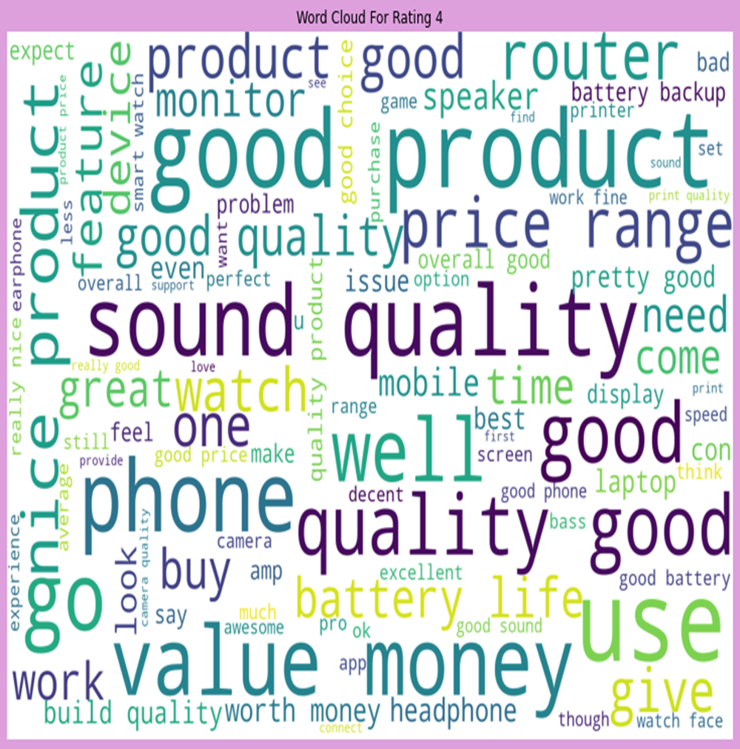
Word Cloud For Rating 4

Slide 12
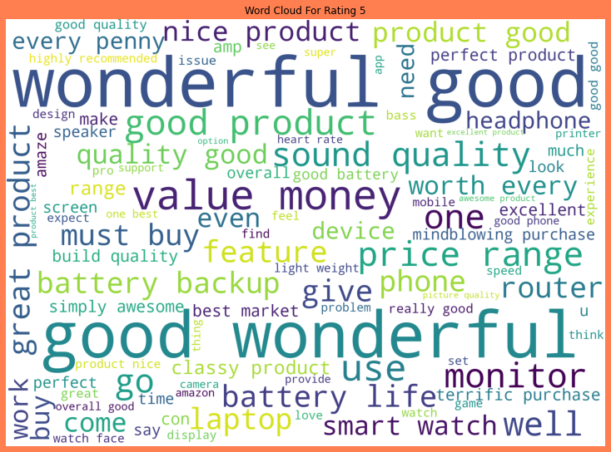
Word Cloud For Rating 5

Slide 13
Features Engineering
Data Processing
Replaced null values by fillna() method.
Remove irrelevant information.
Data Cleaning
Replaced irrelevant information by replace method.
Text Preprocessing
Text processing, Lemmatization and Normalization- Standardization.
Dealing with Outliers
Z-score method is used to remove outliers.

Slide 14
Model Initiating
Split dataset using Train_Test Split
Dealing with imbalancing
Model Building
Accuracy Score
Cross-Validation Score

Slide 15
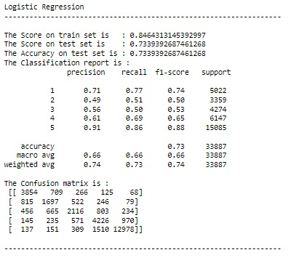
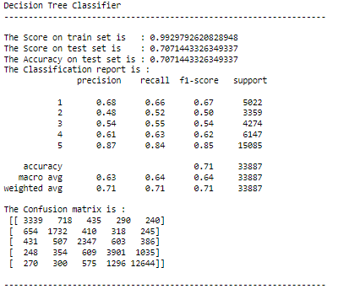
Insights of all Models
Continued…………….

Slide 16
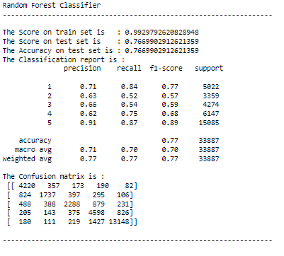
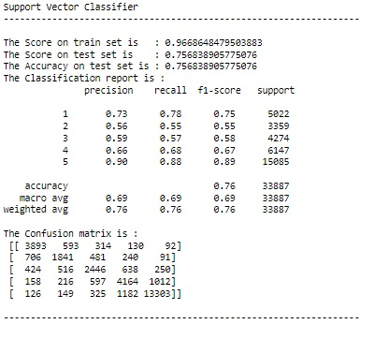
Continued…………….

Slide 17
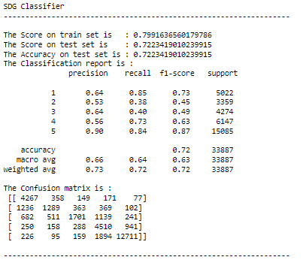

Slide 18
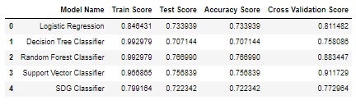
Scores of All Models
SDG performed well on this dataset as SDG Classifier have good accuracy, comparatively less cross-validation score. So final model on this dataset is SDG Classifier.

Slide 19
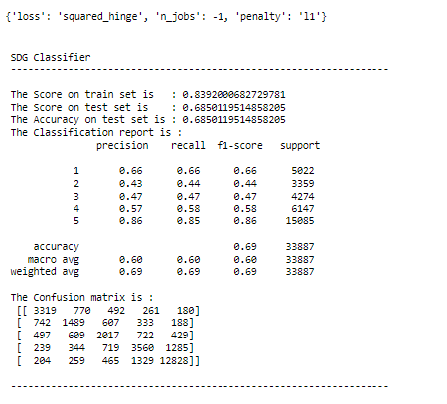
Hyperparameter Tuning
After hyperparameter tuning, not able to improve performance. So, default parameters are best parameters.

Slide 20
Conclusion
In this study, I collected the different products review & rating from two different platform named as flip-kart and amazon through web scraping. The data is usually simple but it contains null values. I have done data pre-processing to replaced null values and extra information, text pre-processing for data cleaning, lemmatization, normalization-standardization, noise removal. I also choose equal number of text from each rating class to eliminate problem of imbalance. By EDA, I observed the frequently, rarely, rating wise word cloud. After that, build the model by splitting the dataset into train and test set and used evaluation metrics. I used 5 different type of machine learning model for this dataset. Based on performance and evaluation metrics I selected SDG Classifier as the final model. I got around 72.23% accuracy with less cross validation score.

Slide 21
Thank You………

